Slide 1

TEXT ENCRYPTION USING VARIOUS ALGORITHMS
NIHAL AGARWAL – 2010030413
JAIDEEP SHARMA – 2010030374
T VENKATA SAI SATHVIK – 2010030361
SHAIK ABDUL SHAAN – 2010030153

Slide 2

INTRODUCTION
Encryption is a way for data-messages or files to be made unreadable, and ensuring that only authorized person can access the data. Encryption means securing digital data by converting it from readable format into an encoded format. Encrypted data can be read after it’s been decrypted. Encryption is a building block of data security. It is most important way to ensure a computer system’s information can’t be stolen or read by someone unauthorized. Data encryption security is used by individual users and companies and organizations, to protect the information sent between server an browser. The information can be anything, It may be messages, personal data, payment data. An encryption software, also known as encryption algorithm is used to develop an encryption scheme that theoretically can only be broken with large computational power.
2/01/2022
TEXT ENCRYPTION USING VARIOUS ALGORITHMS
2

Slide 3

ABSTRACT
Now days, Data security is very challenging issue that touches many areas including computers and communication. Recently, we came across many attacks on cyber security that have played with the confidentiality of the users. These attacks just broke all the security algorithms and affected the confidentiality, authentication, integrity, availability, and identification of user data. Cryptography is one such way to make sure that confidentiality, authentication, integrity, availability and identification of user data can be maintained as well as security and privacy of data can be provided to the user. Encryption is the process of converting normal data or plaintext to something incomprehensible or cipher-text by applying mathematical transformations or formulae. These mathematical transformations or formulae used for encryption processes are called algorithms.
2/01/2022
TEXT ENCRYPTION USING VARIOUS ALGORITHMS
3

Slide 4
LITERATURE REVIEW
AUTHOR | TITLE | PUBLISHED SOURCE | METHODS | FINDINGS
Rohan Rayarikar, Sanket Upadhyay, Priyanka Pimpale | SMS encryption using AES algorithm on Android | https://www.researchgate.net/file.PostFileLoader.html?id=55c212f66225ff9e068b4623&assetKey=AS%3A273825676103681%401442296536278 | In this source, they have used AES Algorithm, and have explained working of SMS in android | Messages are encrypted for sender as well as receiver, use of AES algorithm has 128 bits of cipher key, which has 2^128 possibilities for attacker to break which is almost impossible.
K. Nanda Kishore, Sujan Chhetri | A Novel Text Encryption Algorithm using enhanced Diffie Hellman and AES | https://d1wqtxts1xzle7.cloudfront.net/64601037/Kishore%20Karanam%20-%20V8I6-0010-with-cover-page-v2.pdf?Expires=1643454742&Signature=YkvGD750B7gkrvk8BG~J5L1AqHhZF~Coq1l7gMqqVE16rNU3jMrTHIjKgZpcZV1Gn9KukQ8yINmIDPwLYwbj6U8vOlKXHWBWbRcQNszclHosVoKCkkWDkFbd1JTxUjjJoJzDacwpDJofESOYTktGF93RjoITS6ErPz9HwpszvNnTuNnFBSONVZhNaoc6djnuQAPQnKbHGSx3xqf~yg3c57ofkUUI8cPdarsyhI1kHobTVU1xu2fFdJoD-H886b5pX0~xvbEkRgCILm4WrW5GJpw-KPTNQFi4xHc5Rl4rD07F-eBPU9PG07h23SNFtYNzrIWnDGAMmLfemN9Ye2KUFQ__&Key-Pair-Id=APKAJLOHF5GGSLRBV4ZA | Diffie-Hellman key exchange algorithm, AES Algorithm, java implementation | Generating a highly secure key for defending against attacks and then applying AES algorithm for encrypting and decrypting.
2/01/2022
TEXT ENCRYPTION USING VARIOUS ALGORITHMS
4

Slide 5
LITERATURE REVIEW
AUTHOR | TITLE | PUBLISHED SOURCE | METHODS | FINDINGS
Zahraa Ch. Oleiwi, Wasan A. Alawsi, Wisam. Ch. Alisawi, Ali S. Alfoudi, Liwa H. Alfarhani | Overview and Performance Analysis of Encryption Algorithms | https://www.researchgate.net/publication/347041834_Overview_and_Performance_Analysis_of_Encryption_Algorithms | Analysis of different encryption algorithms for encryption. | AES algorithm is the effective among symmetric encryption algorithms and RSA algorithm is the best in asymmetric algorithms
Dr. Prerna Mahajan AbhishekSachdeva | A Study of Encryption Algorithms AES, DES and RSA for Security | https://computerresearch.org/index.php/computer/article/view/272/272 | Using RSA, DES, AES algorithms for encryption and analysing the time taken for encryption | RSA algorithm takes longer time for the process AES, DES show very minor difference between time taken.
2/01/2022
TEXT ENCRYPTION USING VARIOUS ALGORITHMS
5

Slide 6
LITERATURE REVIEW
AUTHOR | TITLE | PUBLISHED SOURCE | METHODS | FINDINGS
Roshni Padate, Aamna Patel | Encryption and decryption of text using AES Algorithm | https://citeseerx.ist.psu.edu/viewdoc/download?doi=10.1.1.639.7316&rep=rep1&type=pdf | Using AES algorithm for encrypting and decrypting using AES key expansion | We have to generate a key which will be known to sender and receiver, so that they can encrypt the file and decrypt the text and can only be seen after authorizing it with proper key
2/01/2022
TEXT ENCRYPTION USING VARIOUS ALGORITHMS
6

Slide 7
WORKING OF ENCRYPTION
Algorithm/ciphers
Ciphers, also called encryption algorithms, are systems for encrypting and decrypting data. A cipher converts the original message, called plaintext, into ciphertext using a key to determine how it is done.
These are the rules of encryption process. The key length, functionality, and features of encryption system in use determine the effectiveness of encryption.
Key
An encryption key is a randomized string of bits which is used to encrypt or decrypt data. Each key is unique , and longer keys are hard to break.
There are two types of keys, that are symmetric and asymmetric
Symmetric keys system, in this system , accessors of the data are having the same keys.
Asymmetric keys system, in this system, one key is secret which is private key, and other is public key which will be available with anyone accessing in public.
2/01/2022
TEXT ENCRYPTION USING VARIOUS ALGORITHMS
7

Slide 8
WORKING OF DECRYPTION
Decryption is the process of converting unreadable ciphertext to readable information.
In decryption, the system extracts and converts the encrypted form of data to text or images based on the information which is understandable by humans as well as system.
Decryption is performed using keys which are decided by the sender and receiver which will be available with both the organizations and can be used for transmitting data from system to server in encrypted form and then from server to system in decrypted form.
2/01/2022
TEXT ENCRYPTION USING VARIOUS ALGORITHMS
8

Slide 9
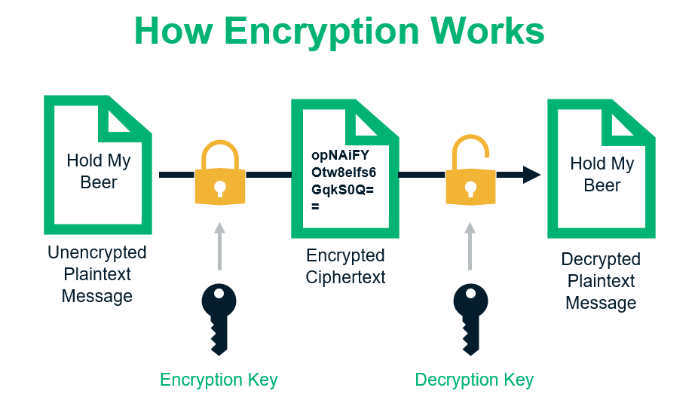
WORKING OF ENCRYPTION
2/01/2022
TEXT ENCRYPTION USING VARIOUS ALGORITHMS
9

Slide 10
AES ALGORITHM
AES stands for Advanced Encryption Standard and is trusted algorithm as the standard by the U.S. government and also many organizations. It is highly efficient in 128-bit form, and it can also use 192 and 256 bits for string encryption purposes.
It is considered impervious to all the attacks, except the brute-force, which attempts to decipher messages using possible combinations such as 128,192,256-bit cipher.
2/01/2022
TEXT ENCRYPTION USING VARIOUS ALGORITHMS
10

Slide 11
So, we will be implementing text encryption using AES algorithm and RSA algorithm
AES stands for Advanced Encryption Standard and is in wide use around the world. It falls into a class of encryption methods called “symmetric” encryption. That is, the same secret (an encryption key) is used to encrypt the data, and also used to decrypt the data.
RSA falls into a class of encryption methods called “asymmetric” encryption. The name asymmetric follows from the fact that there are two related secrets, or keys, used for encryption. One is called a public key, and the other is called a private key.

Slide 12
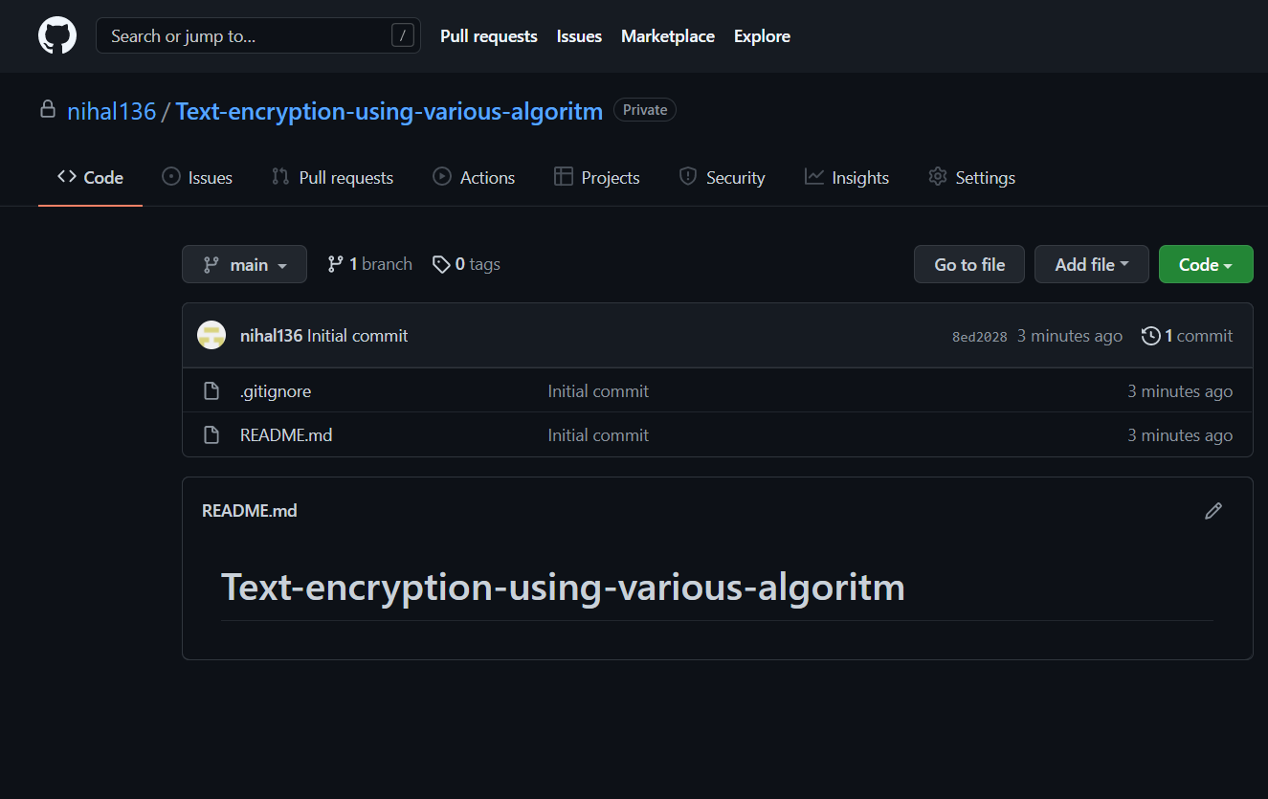

GITHUB SETUP
https://github.com/nihal136/Text-encryption-using-various-algoritm

Slide 13
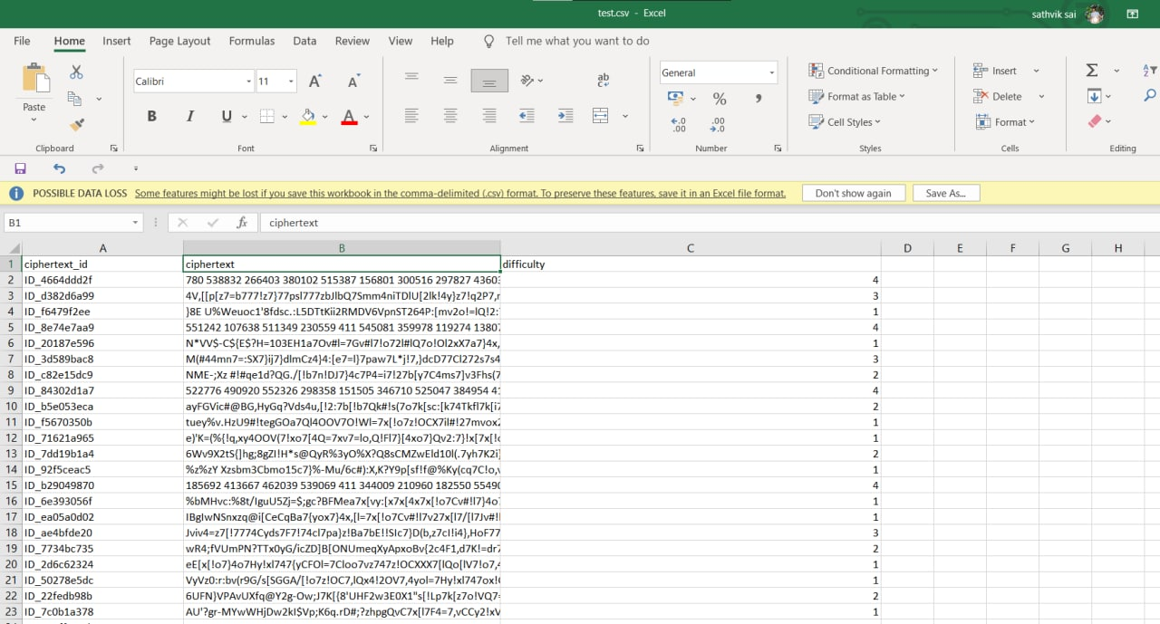
DATASET COLLECTION
https://www.kaggle.com/c/ciphertext-challenge-ii/code

Slide 14
IMPLEMENTATION OF AES ALGORITHM

Slide 15
FLOW CHART
START
Give choice
Encrypt text
Decrypt Text
Exit
var t
TRUE
if t==1
Input “choice a option from 1,2,3:”→ t
input text for encryption
FALSE
elif t==2
FALSE
else
System exit
Input key for encryption
TRUE
Input key for decryption
Print encrypted text as plain text
Print decryption done
Print encryption done

Slide 16
CODE
from Crypto.Cipher import AES def pad(entry): padded=entry+(16-len(entry)%16)*'[' return padded print("1. Encrypt text\n2. Decrypt Text\n3. Exit") k="" l="" cip="" while True: t = int(input("Enter Your Option: ")) if t==1: plain_text=input("Enter text to be encrypted: ") plain_text=pad(plain_text) plain_text=plain_text.encode('UTF-8') print("encoded text with padding done till 16 bits: ",plain_text) key=input("Enter key to encrypt the text: ") k=key key=pad(key) key=key.encode('UTF-8') l=key cipher=AES.new(key,AES.MODE_ECB) ciphertext=cipher.encrypt(plain_text) print("encrypted cipher form: ",ciphertext) cip=ciphertext print("**********************Encryption Done************************")
elif t==2: key1=input("Enter key for decryption: ") if key1==k: cipher2=AES.new(l,AES.MODE_ECB) data=cipher.decrypt(cip) data=data.decode('UTF-8') unpad=data.find('[') data=data[:unpad] print("Decrypted Data: ",data) print("**********************Decryption Done************************") else: print("Alert!! Wrong Password, Try Again !!!!") else: print("**********************THANK YOU************************") exit(0)

Slide 17
IMPLEMENTATION OF RSA ALGORITHM

Slide 18
FLOW CHART
START
Give choice
Encrypt text
Decrypt Text
Exit
var t
TRUE
if t==1
Input “choice a option from 1,2,3:”→ t
input text for encryption
FALSE
elif t==2
FALSE
else
System exit
TRUE
Print encrypted text as plain text
Print decryption done
Print encryption done

Slide 19
CODE
import rsa
public_key, private_key = rsa.newkeys(1024)
em=""
print("1. Encrypt text\n2. Decrypt Text\n3. Exit")
while True:
t=int(input("Enter your option: "))
if t==1:
message = input("Enter the message: ")
res = bytes(message,'utf-8')
# print(res)
eme=rsa.encrypt(res,public_key)
# print(eme)
em=eme
print("**********************Encryption Done************************")
elif t==2:
dm=rsa.decrypt(em,private_key)
print(dm.decode())
print("**********************Decryption Done************************")
else:
print("**********************THANK YOU************************")
exit(1)
exit(1)

Slide 20
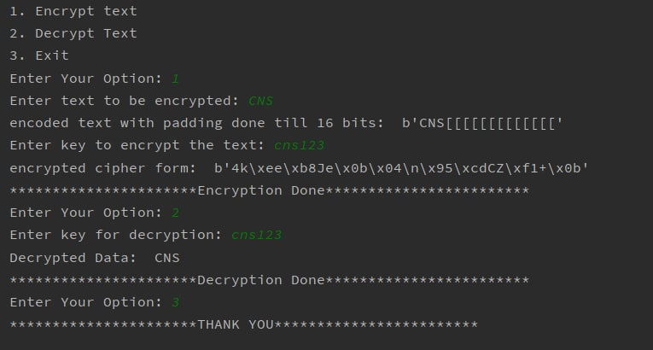
BETA TESTING OF AES ALGORITHM

Slide 21
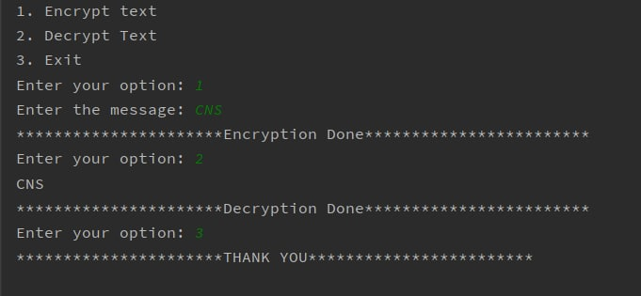
BETA TESTING OF RSA ALGORITHM

Slide 22
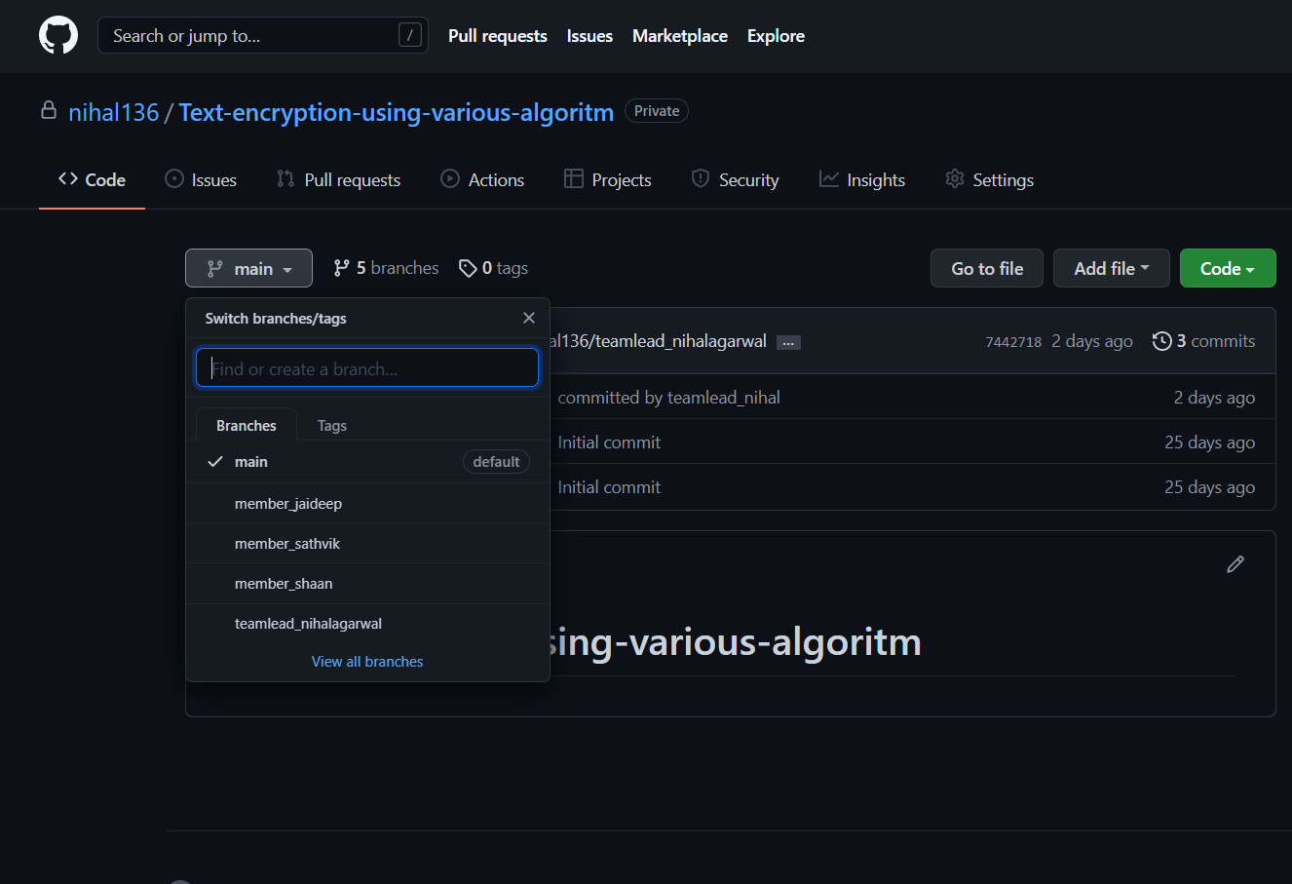
GITHUB COMMITS

Slide 23
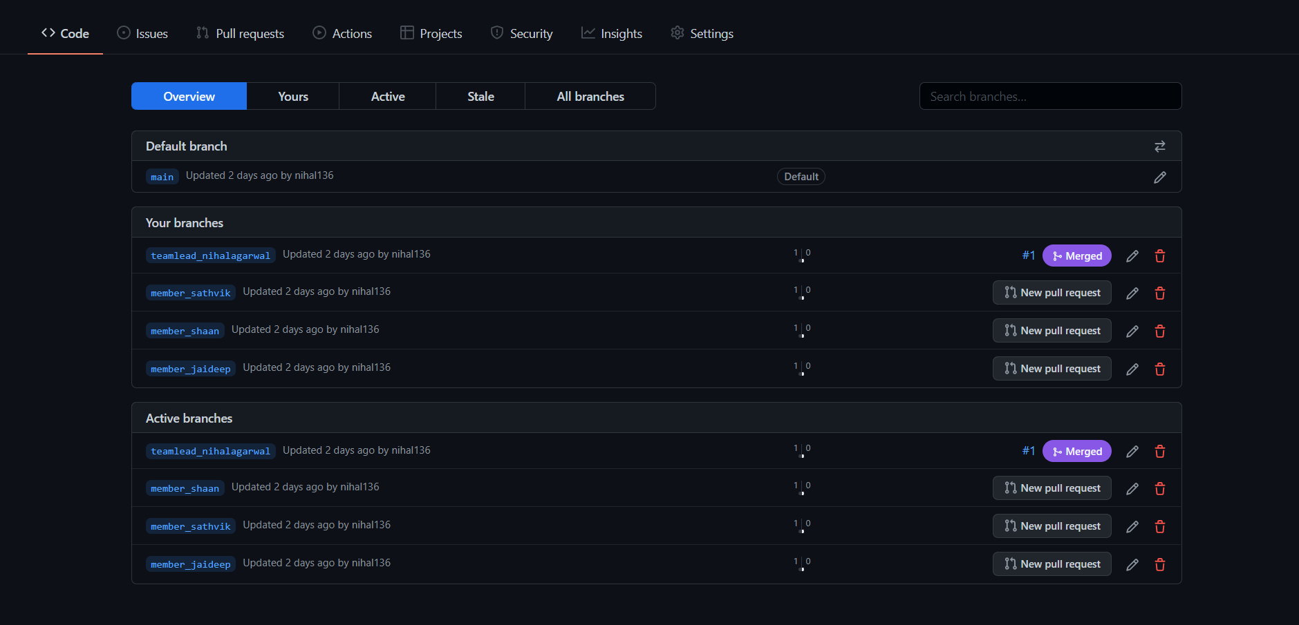
GITHUB COMMITS

Slide 24
WORK IN PROGRESS
Selection of algorithms to be used → AES and RSA Algorithm
Literature Review
GITHUB setup
Implementation of AES Algorithm
Testing the implemented AES Approach
GITHUB commits

Slide 25
THANK YOU
2/01/2022
TEXT ENCRYPTION USING VARIOUS ALGORITHMS
25

